Slide 1
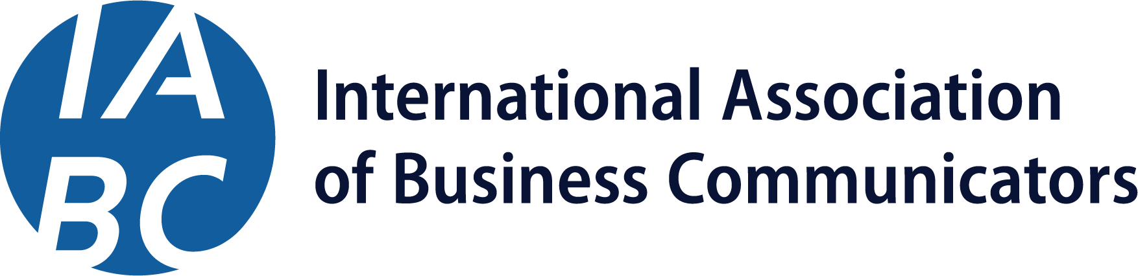
Why IABC Membership?

Slide 2
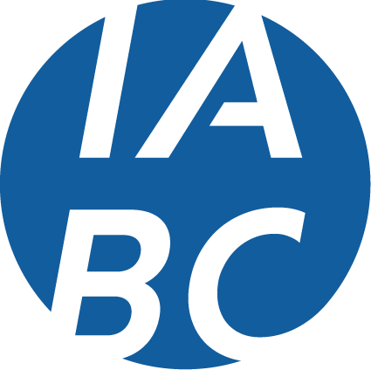
#1 Reason for Becoming an IABC Member: Build Your Skills, Boost Your Impact
I
In-Demand Skills Learn the communication skills employers look for and perform with confidence from day one.
Access to Experts Learn from experienced communicators, mentors, and peers who share real-world insight.
Build Your Network Form meaningful connections with peers and professionals who support learning, visibility, and growth.
Continuous Learning Gain tools and perspective that help you grow faster and take the next step with clarity.
A
B
C

Slide 3
Setting a Standard of Excellence Since 1970
Since 1970, IABC has connected communicators around the world, setting a standard of excellence for the profession. As a global association, we provide members with access to the latest industry insights, educational resources, and certification programs, helping them stay current on emerging trends and evolving best practices. By sharing knowledge and connecting professionals across industries and continents, IABC ensures communicators remain relevant, skilled, and prepared to make an impact in today’s fast-changing world.

Slide 4
Member Benefits and Value

Slide 5

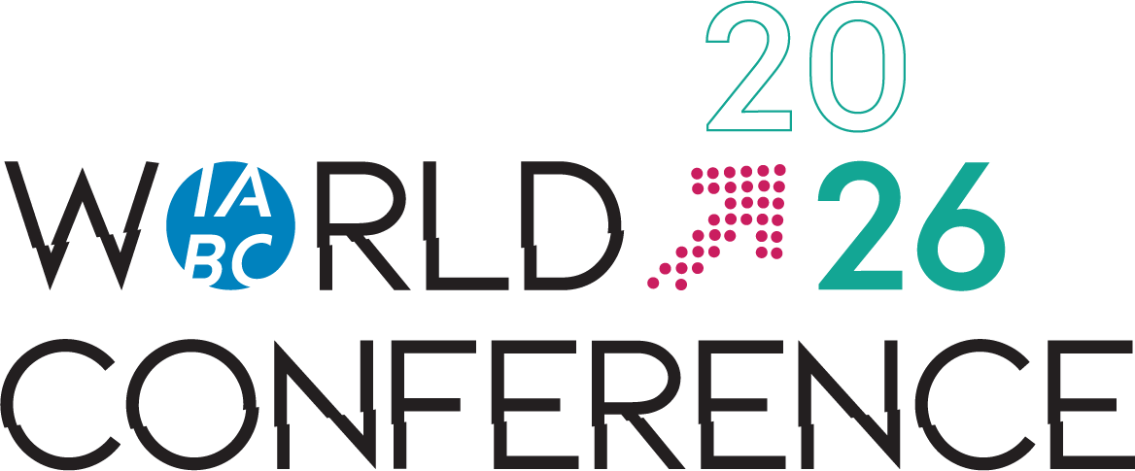
IABC World Conference Experience the Premier Global Communications Event
Kickstart your communication career at IABC World Conference, our premier annual event for communicators around the world. Join us 14-16 June 2026 in Toronto for in-person sessions, hands-on workshops, and networking opportunities to help you grow your skills, build your network, and gain a career edge.
Notes:
Marlee

Slide 6

Advance Your Skills On Demand Learn Anytime, Anywhere
IABC On Demand helps early-career communicators build essential skills with online courses in areas like strategic communication, storytelling, and digital engagement.
Members also receive discounts on live trainings, including Master Classes on leadership and crisis communication, for continuous professional development and exposure to the field.
Notes:
Marlee

Slide 7
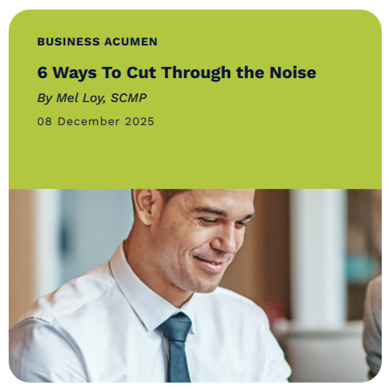
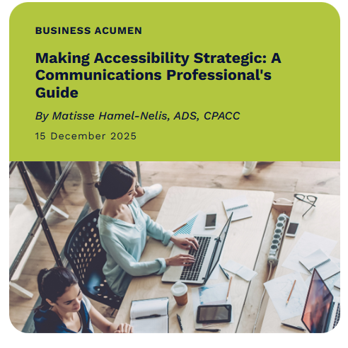
IABC’s Official Online Publication, Catalyst Fuel for Your Professional Voice
Catalyst gives you the insights and guidance you need to grow and make an impact. Get full access to member-only content, including case studies, PodCatalyst episodes, and other resources to stay ahead and strengthen your professional voice.

Slide 8

Build Community Connect Locally, Lead Globally
IABC membership gives you access to a vibrant global network of communication professionals.
Participate in Local Chapter Events: Meet peers and mentors in your area, learn from real-world experiences, and build relationships beyond your day-to-day role.
Join Shared Interest Group (SIG) Gatherings: Connect with professionals who share your interests, explore career paths, and learn from people just a few steps ahead.
Find your local IABC Chapter Region here.
Notes:
Marlee

Slide 9
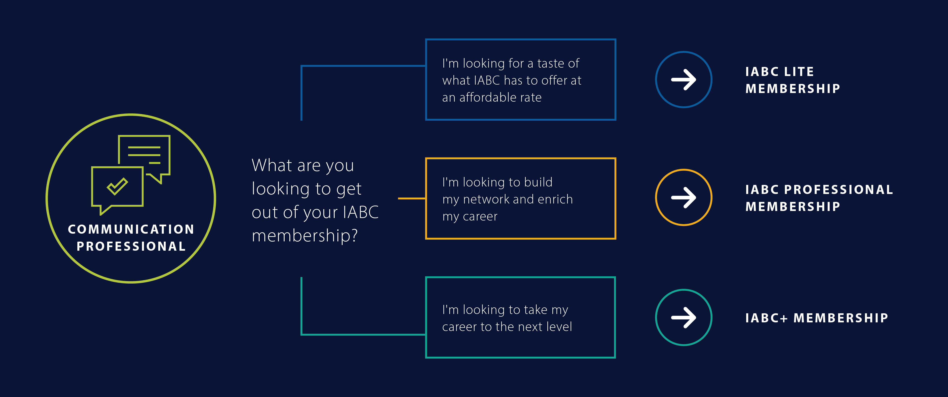
Find Your IABC Membership Match

Slide 10

Everything You Need for Just $0.32 a Day There’s no better time to become an IABC Member.
With the new Member Lite option, you have an affordable entry point into the global IABC network.
Connect with professionals, access exclusive insights, and stay ahead in the fast-moving communications landscape — all for just $115 USD annually (~$0.32/day).

Slide 11

Are You a Student? We’ve got something for you too!
With a Student Membership, you can get a head start on your communication career before you graduate, at an affordable price!
Connect with professionals, access exclusive learning resources, and gain insights to grow your skills, all for just $40 USD annually (~$0.11/day).

Slide 12
Join the Essential Community for Early Career Communicators
Visit: iabc.com/membership/join

