Slide 1
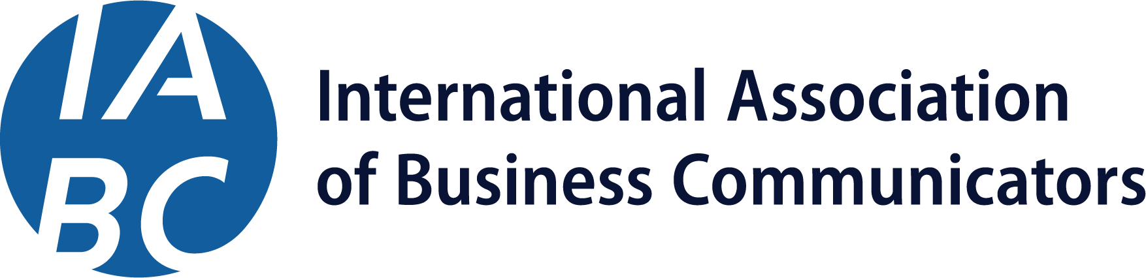
Why IABC Membership?

Slide 2

#1 Reason for Becoming an IABC Member:
To keep knowledge and skills relevant.
I
In Demand Skills
Communication is the #1 skill employers want (LinkedIn, 2024)
Adaptive Thought Leadership
Independent voices and digital platforms are reshaping influence (Deloitte, 2025)
Bold With Technology
AI and emerging tools are changing how communicators create and deliver messages (MDPI, 2025)
Continuous Learning
59% of the global workforce will need reskilling/upskilling by 2023 (World Economic Forum, 2025)
A
B
C

Slide 3
Setting a Standard of Excellence Since 1970
Since 1970, IABC has connected communicators around the world, setting a standard of excellence for the profession. As a global association, we provide members with access to the latest industry insights, educational resources, and certification programs, helping them stay current on emerging trends and evolving best practices. By sharing knowledge and connecting professionals across industries and continents, IABC ensures communicators remain relevant, skilled, and prepared to make an impact in today’s fast-changing world.

Slide 4
Member Benefits and Value

Slide 5
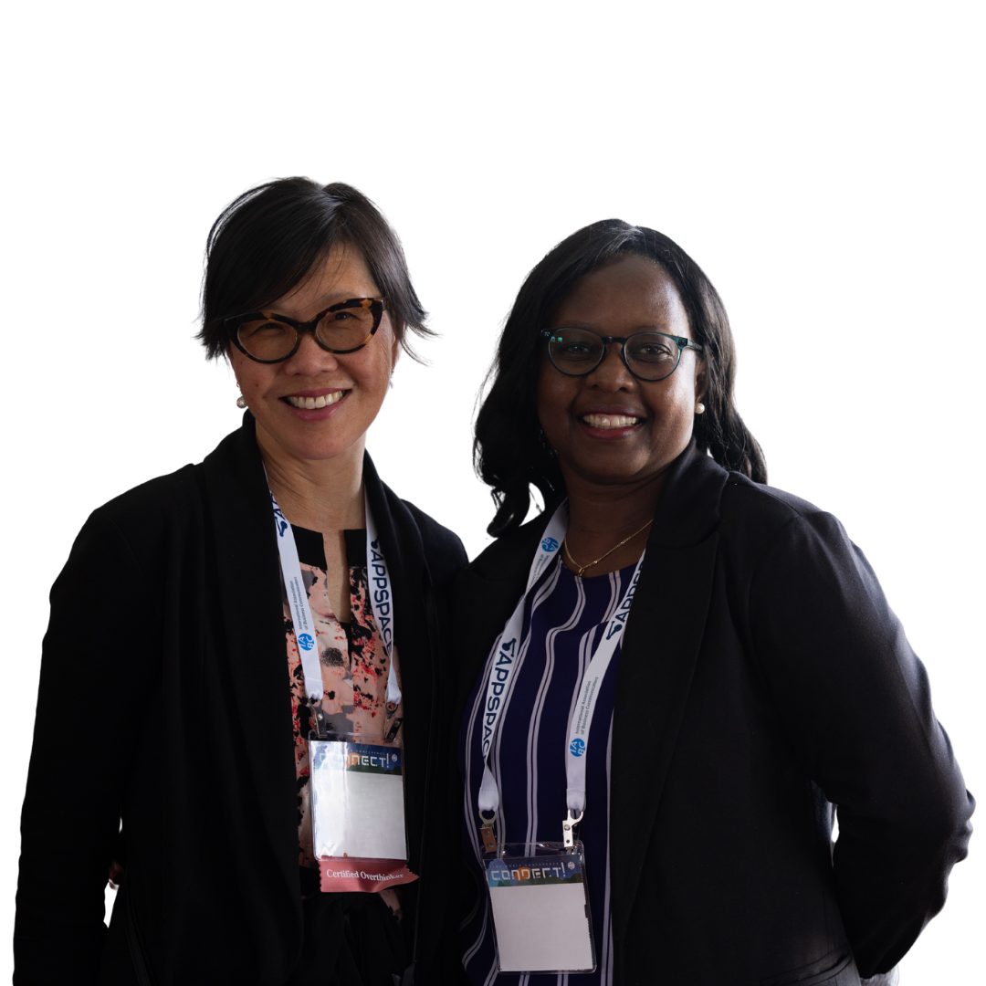
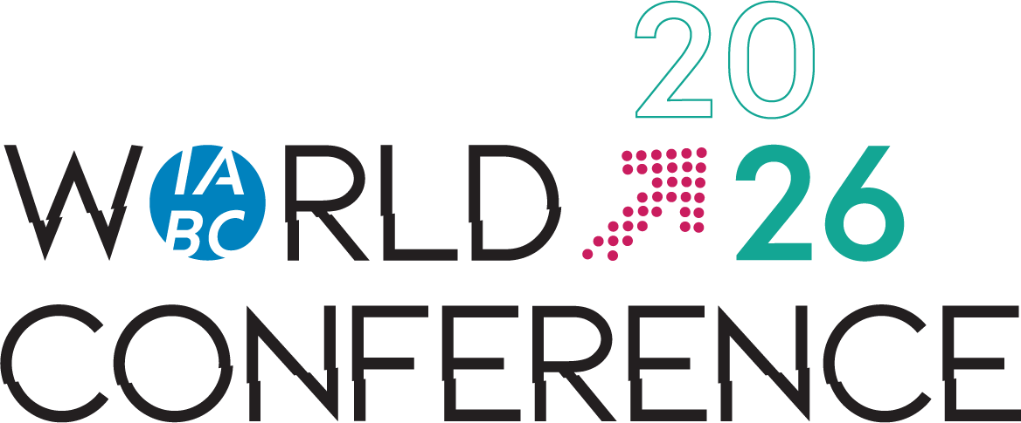
IABC World Conference
Experience the Premier Global Communications Event
IABC World Conference is our premier annual event, uniting communicators from around the world. Join us 14-16 June 2026, in Toronto to attend in-person sessions, workshops, and networking — with exclusive member discounts to advance your career.
Notes:
Marlee

Slide 6

Advance Your Skills On Demand
Learn Anytime, Anywhere
IABC On Demand gives members access to online courses on topics like strategic communication, storytelling, and digital engagement.
Members also receive discounts on live trainings, including Master Classes on leadership and crisis communication, for continuous professional development.
Notes:
Marlee

Slide 7
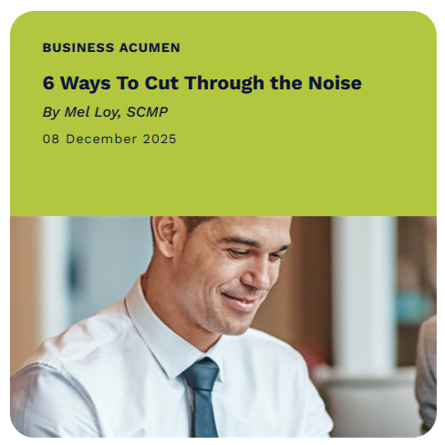
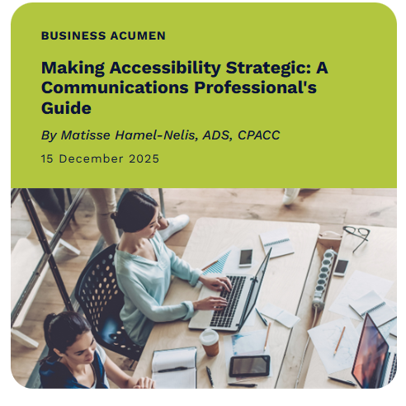
IABC’s Official Online Publication, Catalyst
Stay Informed and Ahead of Trends
Catalyst delivers insights and thought leadership through the newsletter and online articles. Members get full access to member-only content, including case studies, PodCatalyst episodes, and other resources to stay relevant and make an impact.

Slide 8
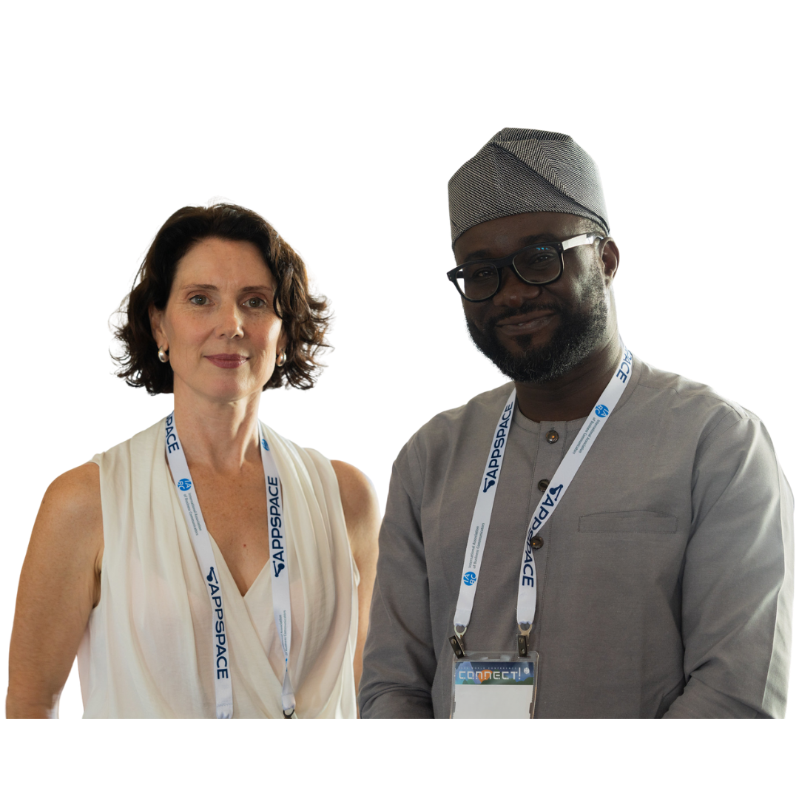
Build Community
Connect Locally, Lead Globally
IABC membership gives you access to a vibrant global network of communication professionals.
Participate in Local Chapter Events: Exchange ideas and connect with peers in your area
Join Shared Interest Group (SIG) Gatherings: Gain mentorship and collaborate with professionals who share your interests
Find your local IABC Chapter Region here.
Notes:
Marlee

Slide 9
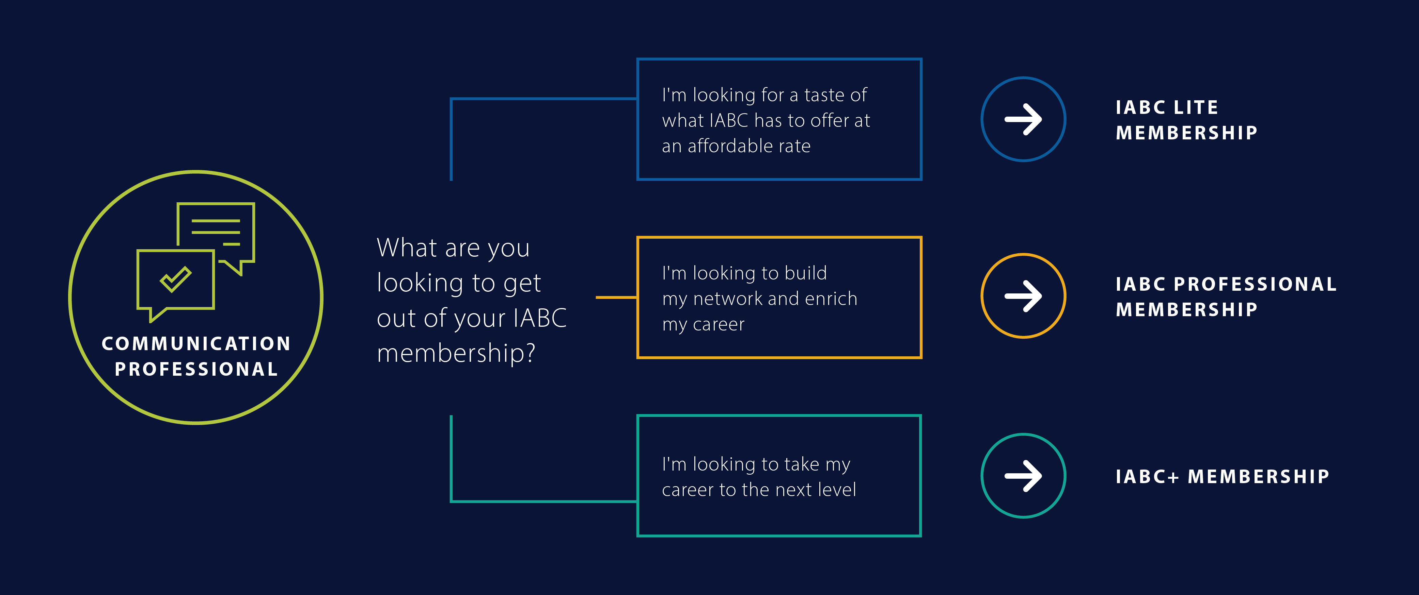
Find Your IABC Membership Match

Slide 10

Everything You Need for Just $0.32 a Day
There’s no better time to become an IABC Member.
With the new Member Lite option, you have an affordable entry point into the global IABC network.
Connect with professionals, access exclusive insights, and stay ahead in the fast-moving communications landscape — all for just $115 USD annually (~$0.32/day).

Slide 11
Join the Essential Community for Communicators
Visit: iabc.com/membership/join

